Slide 1
Meaning making and meaning shaping the contribution of oral storytelling to literacy learning
Dr Alastair K Daniel
www.storytent.co,.uk Alastair.Daniel@roehampton.ac.uk
Notes:
Meaning making and meaning shaping - the contribution of oral storytelling to literacy learning
In The Meaning Makers, his seminal study of how language and literacy develop, Gordon Wells (2009) suggests that children’s literacy development is supported most in homes in which stories are shared. His view, that storying is a fundamental way in which we make sense of the world, aligns both with Gottschall’s suggestion that humans are homo fictus or ‘the great ape with the storytelling mind (2012, p3), and also perspectives that see storytelling as, by nature, a social activity. In this session, Alastair K Daniel will lead a discussion on the role of oral storytelling in the cooperative shaping of ideas and language. He will ask the group to consider their own experiences of storytelling practices, and the way in which those practices relate to broader dimensions of literacy, both in spoken language and written text. He will highlight research into the effects of storytelling on literacy development, and explore some of the storytelling activities that are used in schools to support literacy teaching and learning, including teacher-led story making and Kamishibai (Japanese ‘paper theatre’).
Dr Alastair K. Daniel currently works at the University of Roehampton as the Principal Lecturer in Primary English Education. Before entering full time academia in 2010, he spent twelve years dividing his time between university lecturing and educational storytelling in schools in the UK and Belgium. He is an active researcher into storytelling performance and associated pedagogies, and (in particular) focuses on the contribution of environmental context to story creation and telling. Alastair’s blog ‘Talking Storytelling’ can be found at: https://www.akdaniel.co.uk/blog .

Slide 2
An Opening Word from Gordon Wells
…stories have a role in education that goes far beyond their contribution to the acquisition of literacy. Constructing stories in the mind - or storying, as it is called - is one of the most fundamental means of making meaning (Bruner, 1986); as such, it is an activity that pervades all aspects of learning. When storytelling becomes overt and is given expression in words, the resulting stories are one of the most effective ways of making one's own interpretation of events and ideas available to others.
Wells (2009) p214

Slide 3
Key Questions
What is storytelling, and do we need to differentiate it from story writing or story acting (or other artistic approaches to narrative such as choreography, film directing and painting)?
Should storytelling be valued for its nature as oral expression or is its principle role to enhance literacy (with an emphasis on written text)?
Is the celebration of oral culture the work of schools or, rather, that of wider society?
Is there a specific set of storytelling skills that should be developed, or is storytelling, as an innate way of shaping meaning, a practice that we can simply rely upon as appropriate to the circumstances?
Can a storytelling culture, and learning to tell stories, support learners in developing skills in critical literacy?

Slide 4
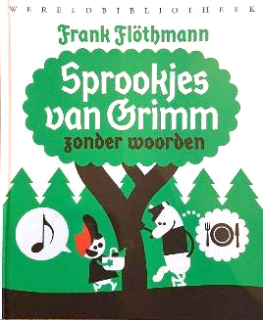
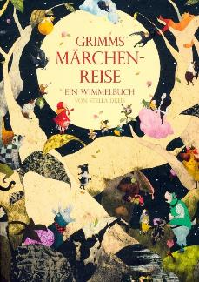
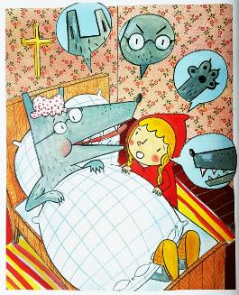
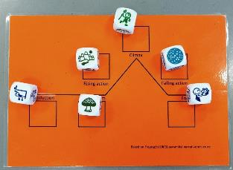
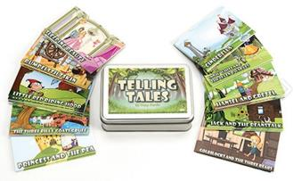
Let's Play with story!

Slide 5
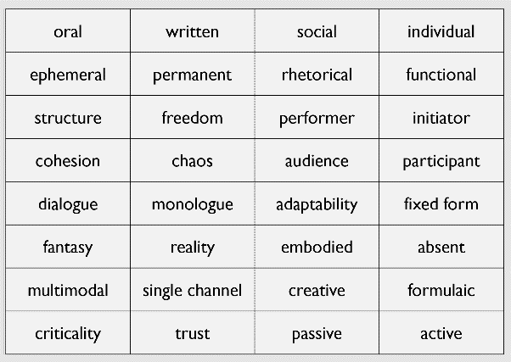
Constructing a semantic field for oral storytelling

Slide 6
Questions to Consider
Did the resource lead you to tell stories or talk about stories (what was the subject of your discourse, the actors in a story, or the story itself)?
Did you identify common folk/fairy tale tropes or archetypes during your exploration of the resource?
How culturally located were your explorations of the resources?
What knowledge, skills or understanding did you bring to your exploration of the resource?

Slide 7
What do we mean by Storytelling?
story
telling
reading
reciting
writing

Slide 8
What do we mean by Storytelling?
telling
performance
sense-making
With reference to Ochs and Capps (2001)

Slide 9
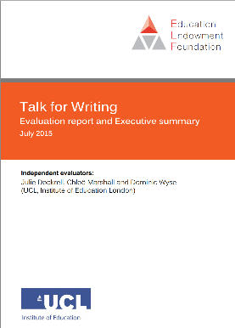
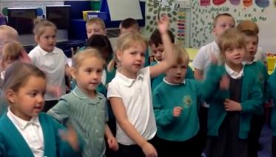
Storytelling: variations in Practice
Conversational storytelling
A storyteller and a group of story hearers
A principal storyteller in a storytelling community
Group story recitation
Group storytelling
Interactive story-making (enacted)
Directed story-making (enacted)
https://www.youtube.com/watch?v=xvsLgrEDtyc
Notes:
Linguistic features typical of younger writers are acquired first in the spoken form, lending weight to the view that supporting oral language skills for younger children will support written skills (Donaldson & Cooper, 2013; Perera, 1984). More specifically, vocabulary has been shown to underpin writing for. children at Key Stage 1 (Dunsmuir & Blatchford, 2004) and for children who experience oral language difficulties (Dockrell & Connelly, 2013). There is also a correlation between children’s use of vocabulary and measures of text quality (Olinghouse & Wilson, 2013). However, these links between oral language and writing vary according to developmental phase and are moderated by reading skills. Firstly, as children get older and literacy skills are more developed, text is more linguistically complex than speaking and draws on a range of different grammatical and structural features that are not, generally, used when speaking. Secondly, there is increasing evidence indicating that the influence of oral language on writing is partly mediated through reading both in terms of word decoding and reading comprehension (Abbott, Berninger, & Fayol, 2010; McCarthy, Hogan, & Catts, 2012).
Dockrell, J., Marshall, C. and Wyse, D. (2015) Talk for Writing Evaluation report and Executive summary, London: Education Endowment Foundation, p10
The study suggests that oral language in not a clear factor in writing proficiency for older primary children. However, one of the key conditions for effective teaching of writing is identified as shared and guided writing. The use of oral language is therefore regarded as separate from these processes. It is, therefore, unclear what the Writers mean by ‘oral language’ and whether they are referring to oral proficiency a communicative capacity. Both shared and guided writing are fundamentally oral in their nature . The aim of these processes is to make visible the writing process and oral story telling is a means that enables events to be connected, though a temporal, sequential and causal relationship.
My Concern with this research is that 'storytelling' is mentioned are in the report -in the results of teacher responses. It does not form a coherent part of the discussion of oral language, or the fundamental narrative-shaping that is at its heart.. This is a performance mode of storytelling (in Ochs and Capp’s terms). The question is here, whether there is meaning shaping – I will come onto this later in a discussion of story and cognition.

Slide 10
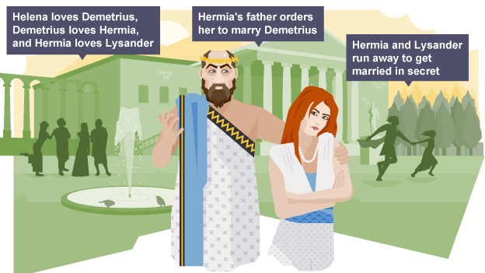
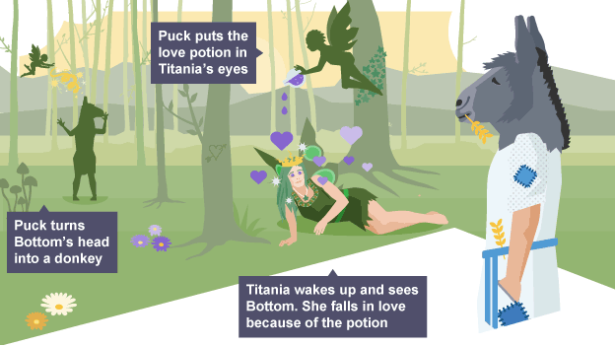
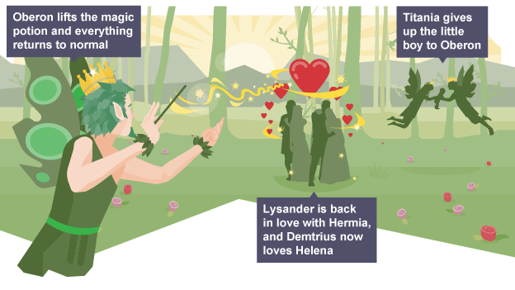
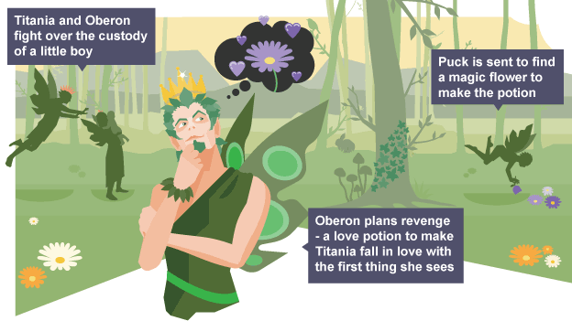
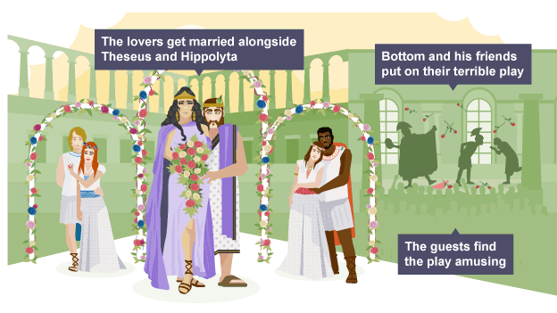
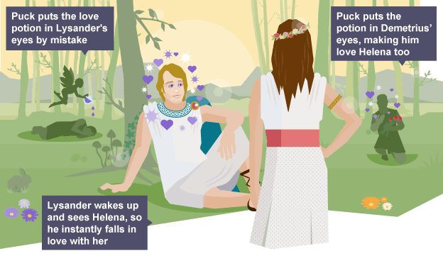
A Midsummer Night’s Dream: Plot Activity
1
5
Print the cards (over), and ensure that the order is shuffled. Distribute the cards (one set per group).
The children:
arrange the cards in order
check the order with an adult
Group storytelling
With the image cards as prompts, the children tell the story. The teller holds an object (such as a pen) to indicate who is acting as the storyteller. They pass the object between them.
The aim is to recall as much as possible but keep the story flowing. Children should feel able to ask each other for help and refer to the character sheet as they wish.
2
6
Bottom and his friends meet to discuss their performance of ‘Pyramus and Thisbe’
3
7
4
8
Notes:
This is sense-making or meaning making

Slide 11
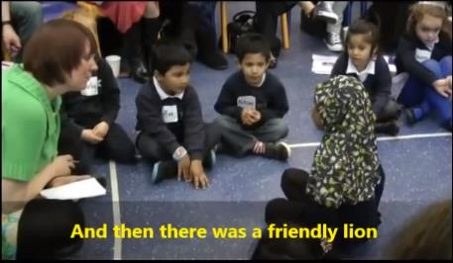
FS/KS1: The Helicopter Technique based on the work of Vivian Gussin Paley (1990)
Teacher-directed story making
https://www.youtube.com/watch?v=UkJl8dyzRQQ&list=PLvtLx1SHcl4mwdHuTCJV7brL_L2PGbA2R&index=18

Slide 12
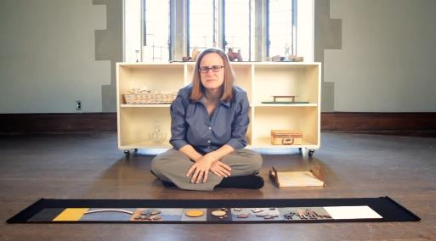
Godly (and not-so-Godly) Play
‘…playing with the language of God and God's people - sacred stories, parables, liturgical action and silence.’
Hyde (2010) p507
https://youtu.be/iBgSHFGnSZI

Slide 13
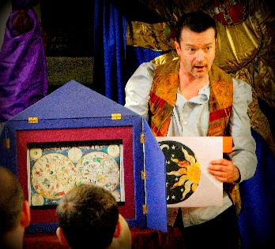
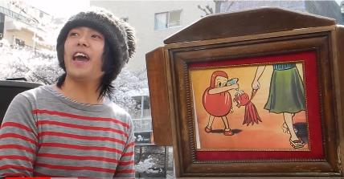
Kamishibai (Japanese Paper Theatre)
https://www.youtube.com/watch?v=GlZty1TZMU4&t=239s&index=5&list=PLvtLx1SHcl4kccGUB7Yb2o1wt2GAmQYWh
Notes:
Kamishibai provides a meaningful performance context for storytelling. Th use of images means that the teller has storyboard / structure which provides the event structure around which the teller can weavetheir own language.
Commercially produced Kamishibai slides have the story on the reverse side which makes the activity one of reading aloud, rather than storytelling.
Start video from 01’40”

Slide 14
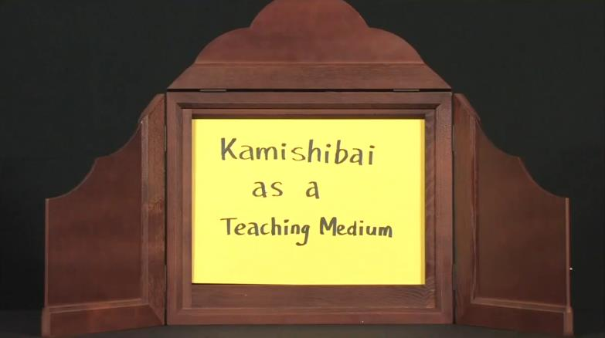
Kamishibai in the Classroom
https://youtu.be/oEId2SFRezY
Notes:
Reading or telling?

Slide 15
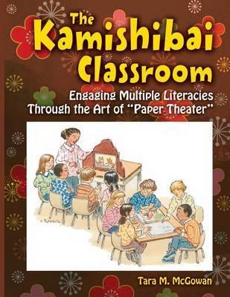
Kamishibai in the Classroom: Reading or Telling?
I do not have the students write their stories down during the course of the workshop, because I believe that they continue to develop their stories as they are retelling them.
McGowan (2010), p23
Notes:
Reading or telling?
I do not have the students write their stories down during the course of the workshop, because I believe that
they continue to develop their stories as they are retelling them. Often writing the words down makes the storyteller
feel as though he or she has to memorize what was written. Writing the script (kyaku/zon) on the back of the cards
requires some guidance, because it is essential to make sure the text for the first card is on the back of the last, the
text for the second on the back of the Horsta, nd so on. The workshops I have done with studentst o teach "the
mechanics of kamishibai" emphasize the theatrical and oral storytelling aspects because my goal is to have them
perform their own stories. This is not to say that important skills for literacy have not been developed during this
process. I have had parents of dyslexic children come up to me after a workshop and thank me for introducing their
children to a way of story-making that does not involve the immediate hurdle of having to form words on a page. 1
have also found this a particularly effective way to work with preliterate children to develop their own story-making
Skill.
McGowan (2010), p23

Slide 16
Lines of Enquiry
oracy and literacy
social engagement
storytelling and literacy
cultural engagement
critical literacy

Slide 17
Why Storytelling?
[Storytelling assists] children in expanding story comprehension, oral retelling, and recognizing the elements of a story.
Isbell, R; Sobol, J; Lindauer, L and Lowrance , A (2004) ‘The Effects of Storytelling and Story Reading on the Oral Language Complexity and Story Comprehension of Young Children’ in Early Childhood Education Journal, Vol. 32, No. 3
...while both showed strong positive effect, storytelling was superior to story reading for student vocabulary development and for comprehension.
Haven, Kendall (2007). Story Proof; Westport CT: Libraries Unlimited: 114

Slide 18
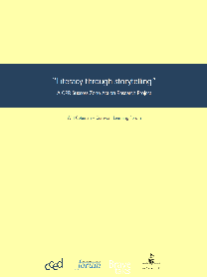
Storytelling to Writing Four month intervention with Year 6
The results clearly show a significant difference between the participating and control populations. …. Not all children showed any improvement in marks gained over the four-month study period but 60% of the participating population did whereas only 34% of the control population did.
…
…the storytelling intervention did have a significant impact on raising the standard of fiction writing outcomes.
(Coleman, 1991: 12 and 14)
Notes:
Linguistic features typical of younger writers are acquired first in the spoken form, lending weight to the view that supporting oral language skills for younger children will support written skills (Donaldson & Cooper, 2013; Perera, 1984). More specifically, vocabulary has been shown to underpin writing for. children at Key Stage 1 (Dunsmuir & Blatchford, 2004) and for children who experience oral language difficulties (Dockrell & Connelly, 2013). There is also a correlation between children’s use of vocabulary and measures of text quality (Olinghouse & Wilson, 2013). However, these links between oral language and writing vary according to developmental phase and are moderated by reading skills. Firstly, as children get older and literacy skills are more developed, text is more linguistically complex than speaking and draws on a range of different grammatical and structural features that are not, generally, used when speaking. Secondly, there is increasing evidence indicating that the influence of oral language on writing is partly mediated through reading both in terms of word decoding and reading comprehension (Abbott, Berninger, & Fayol, 2010; McCarthy, Hogan, & Catts, 2012).
Dockrell, J., Marshall, C. and Wyse, D. (2015) Talk for Writing Evaluation report and Executive summary, London: Education Endowment Foundation, p10
We will explore the problem with always linking storytelling to writing a little later…

Slide 19
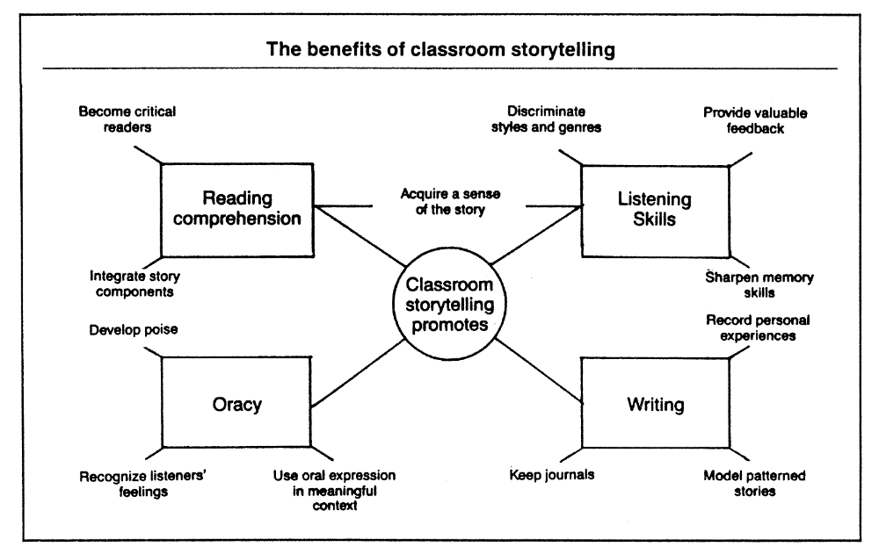
Peck, J. (1989) Using Storytelling to Promote Language and Literacy Development : In The Reading Teacher, Vol. 43, No. 2

Slide 20
Listening to Stories literacy benefits that children can gain from listening to oral storytelling include
practice in visualization
cognitive engagement
critical thinking
story sequencing.
Agusto, 2016: 23

Slide 21
An under-researched area
Colquhous, C. (2018) All the better to hear you with: Tips, Theory and Proof for the Educatinal Benefits of Storytelling. In Willison, C. An Introduciton to Storytelling by Storytellers from Around the Wordl. Stroud: The History Press / The Society of Storytelling. pp98-110
Notes:
This research is t predicated on a false dichotomy in . which story telling is contrasted with decontextualized rote learning of facts. ‘Research such as this is. Unwelcome in; a field in which there is so little academic .investigation.

Slide 22
Oracy and Literacy
oracy and literacy
social engagement
storytelling and literacy
cultural engagement
critical literacy

Slide 23
Simple developmental model of writing
Text generation (word, sentence, paragraph level)
Working memory
Transcription (handwriting, keyboarding and spelling)
Executive functions (conscious attention, planning, reviewing, revising, strategies for self-regulation)
Adapted from Berninger, V., & Amtmann, D. (2003)
Notes:
Talk provides a means of negotiating between the aspects of writing identified in the SVWr and was used as the basis for the Dockrell et al research.
There is some evidence that the demands on working memory of transcriptional components of writing can continue into adulthood, and so the text generation itself, and the revising and reviewing can be supported by storytelling – Dockrell et al highlight particularly in the early stages of writing proficiency.

Slide 24
Oracy and Literacy: consider the following quotes
. ..the linking of spoken language to written aims and outcomes negatively affects both the process of oral storytelling as well as the quality of S&L practice more generally. . . A rebalancing of the books is required, and a central element of any agenda that desires to reposition oracy in the curriculum needs to also establish the importance of a drive for oral outcomes as an end-point.
Hibbin (2016): 60
Oral expression can exist and mostly has existed without any writing at all, writing never without orality.
Ong, W. (1988) p8
Notes:
…if we want to understand the place of literacy in human societies and the ways children acquire the literacy orientations of their communities, we must recognise two postulates of literacy and language development: (1) Strict dichotomisation between oral and literate traditions is a construct of researchers, not an accurate portrayal of reality across cultures. (2) A unilinear model of development in the acquisition of language structures and uses cannot adequately account for culturally diverse ways of acquiring knowledge or developing cognitive styles.
Shirley Brice Heath (1982: 73) in Street, B. (1984) : 124-5
. . .while the textual reproduction of an orally told story may seem to represent a benign and useful opportunity for practising writing skills to a teacher, to an oral storyteller as a performer who is external to the mandated pedagogic constraints of curriculum and school, it is a counterproductive activity that gets in the way of the cognitive assimilation of structural aspects of narrative.
. ..the linking of spoken language to written aims and outcomes negatively affects both the process of oral storytelling as well as the quality of S&L practice more generally. . . A rebalancing of the books is required, and a central element of any agenda that desires to reposition oracy in the curriculum needs to also establish the importance of a drive for oral outcomes as an end-point.
Hibbin (2016): 60

Slide 25
Social Engagement (towards dialogic storytelling)
oracy and literacy
social engagement
storytelling and literacy
cultural engagement
critical literacy

Slide 26
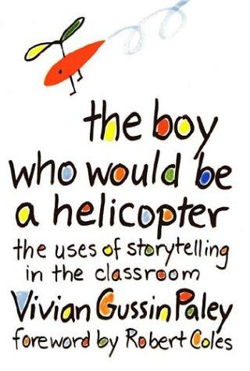
Storytelling as conversation; Storytelling as dialogue
[Storytelling is] ‘a shared process, a primary cultural institution, the social art of language’
Gussin Paley, V. (1990) The boy who would be a helicopter: the uses of storytelling in the classroom Cambridge, Mass: Harvard University Press: 23

Slide 27
Shared (conversational) Storytelling
Sense making
Performance

Slide 28
Individual Performance Storytelling

Slide 29
Individual Performance Storytelling
…there is a circular communication: a dynamic interchange takes place between the performance and the audience.
Whitmore, J. (1994) Directing Postmodern Theater University of Michegan Press p26
Notes:
Audiences not only interpret signifiers and construct meanings from the performance, they also produce signifiers that are read by performers, technicians, and other audience members. . . . During performances at which spectators can easily see one another, the audience becomes a major signifier.
Storytelling is not a spectator sport. The audience actively builds the story and is in the story with the teller. The role of the teller, then, is to give ownership of the story to the audience and to allow the audience to encode the story using the teller as the medium.
Because the storyteller delivers the story in keeping with audience expectations for the nature of oral discourse, audience participation is facilitated. Storytelling ritual, play, and story shape are governed by convention. The teller is constrained to limit his or her behaviour and story reconstructions to those conventions that will, in turn, make the story sensible and that will allow the audience to participate in story making using those features the audience knows and identifies as "story." In particular, a story has a discourse structure that conforms to the literary specifications of the culture in which it originated. The teller makes the story concrete by organising language and paralinguistic elements in accord with these structural conventions. In a sense, the teller stories by fitting information into previously invented and ordered "slots" (Downing and Leong 1982) that the audience recognises as a familiar story pattern (see Chapter 2). Because such patters of slots are mutually understood, the audience can predict and control story shape during telling and participate directly in story construction. As the teller tells, the audience becomes involved in slotting information into known patterns of organisation.
There are five principal types of participation: ritual, coactive, bantering, predictive, and eye contact.” [p9]
Coactive participation, usually a spontaneous and encouraged interaction, draws the audience into movement, song, and language making as the teller reconstructs the story. ... [p10]
Through such negotiating activities as ritual participation, coactivity, bantering, prediction, and eye contact, the audience is able to make the story along with the storyteller, and, by doing so, claims its rightful ownership of the literature. [p11]
Livo, Norma J. and Rietz, Sandra A (1986) Storytelling: Process and Practice. Littleton CO: Libraries Unlimited.

Slide 30
Shared (conversational) Storytelling
Sense shaping and sense making
Process oriented
Co-construction

Slide 31
Shared Performance Storytelling
Sense shaping by tellers
Sense making by audience
Performance oriented
Co-construction

Slide 32
Cultural Engagement
oracy and literacy
social engagement
storytelling and literacy
cultural engagement
critical literacy

Slide 33
Story and Culture
…our lives in culture are more aptly described in easily modifiable story form than in an inflexible true-or-false logic of derivation from first principles. Stories, indeed, provide the most generative and the most preservative medium for both making the strange familiar, and for doing the reverse.
Bruner, (2007) p6

Slide 34
Story and Culture
We more often tell stories to forewarn than to instruct. And because of this, stories are a culture's coin and currency. For culture is, figuratively, the maker and enforcer of what is expected, but it also, paradoxically, compiles, even slyly treasures, transgressions. Its myths and its folktales, its dramas and its pageants memorialise both its norms and its notable violations of them.
Bruner (2002) p13
If we are to understand the relation of storytelling to literacy, we must see the value and nature of narrative as a means by which human beings, everywhere, represent and structure their world. We not only thrive on stories; we also survive by telling and retelling them, as history, discovery and invention.
Meek (1991) p103

Slide 35
Critical Literacy
oracy and literacy
social engagement
storytelling and literacy
cultural engagement
critical literacy

Slide 36
Everyone is a storyteller
“We all recognize ‘story’ …it is an ancient, perhaps natural order of mind - primordial, having grown along with the development of human memory and of language itself. ‘Story’ is a way of organizing language…”
Livo, Norma J. and Rietz, Sandra A (1986) [drawing on Brian Sutton-Smith (1981) The Folkstories of Children.] Storytelling: Process and Practice. Littleton CO: Libraries Unlimited. p5

Slide 37
The Ubiquity of Story
No matter how strict a case is argues - scientifically, philosophically, or legally - it will always be a story, an interpretation of some aspect of the world that is historically and culturally grounded and shaped by human personality.
Fisher (1987) p49
In the end... the narrative and the paradigmatic come to live side by side.
Bruner, J (1986) p43
(a) inside every non-narrative kind of discourse there stalk the ghosts of narrative
and
(b) inside every narrative there stalk the ghosts of non-narrative discourse.
There are always stories crying to be let out and meanings crying to be let in.
Rosen (1987) p12

Slide 38
A Final Word from Gordan Wells
…the reality each one of us inhabits is to a very great extent a distillation of the stories that we have shared: not only the narrative that we have heard and told, read, or seen enacted in drama or news on television, but also the anecdotes, explanations and conjunctures that are drawn upon in everyday conversation, in our perpetual attempts to understand the world in which we live and our experiences in it.
Wells, G. (2009) p216-7

Slide 39
References:
Agosto, D.E. (2016) Why storytelling matters: unveiling the literacy benefits of storytelling. In Children and Libraries Vol. 14 Issue 2, p21-26
Berninger, V., & Amtmann, D. (2003). Preventing written expression disabilities through early and continuing assessment and intervention for handwriting and/or spelling problems: Research into practice. In H. Swanson, K. Harris, and S. Graham (Eds.) Handbook of Learning Disabilities (pp 323- 344). New York: The Guilford Press.
Bruner, J. (2007) Cultivating the Possible Jerome Bruner (currently unpublished)
Bruner, J. (2002) Making Stories: Law, Literature, Life. Cambridge MA: Harvard University Press
Bruner, J (1986) Actual Minds, Possible Worlds. Cambridge Mass: Harvard University Press
Colquhous, C. (2018) All the better to hear you with: Tips, Theory and Proof for the Educational Benefits of Storytelling. In Willison, C. An Introduction to Storytelling by Storytellers from Around the World. Stroud: The History Press / The Society of Storytelling. pp98-110
Coleman, W. (2001) “Literacy through storytelling” A CPR Success Zone Action Research Project, available at http://www.bravetales.co.uk/bt_pdf/literacy_storytelling.pdf (accessed 24/10/18)
Daniel, A.K. (2011) Storytelling across the primary curriculum. Abingdon: Routledge
Dockrell, J., Marshall, C. and Wyse, D. (2015) Talk for Writing : Evaluation report and Executive summary, London: Education Endowment Foundation,
Fisher, W.R. (1987) Human communication as Narrative. Columbia: University of South Carolina
Fox, C. (1993). At the Very Edge of the Forest: The influence of literature on Storytelling by Children. London: Cassell
Freire, P. (1970). Pedagogy of the oppressed. New York Seabury.
Greimas, A.J. (1987) 'Actants, Actors, and Figures in On Meaning: Selected Writing in Semiotic Theory, Translated from the French by P.J Perron and F.H. Collins. On meaning: selected writings in semiotic theory, Minneapolis: University of Minnesota Press, pp106-120
Haven, K. (2007) Story Proof; Westport CT: Libraries Unlimited
Haworth A. (2001) The Re-Positioning of Oracy: A Millennium Project? In Cambridge Journal of Education, 31 (1): 11–23.
Hibbin, R. (2016) Oral Storytelling, Speaking and Listening and the Hegemony of Literacy: Non-Instrumental Language Use and Transactional Talk in the Primary
Hyde, B (2010) Godly Play Nourishing Children’ Spirituality: A Case Study. Religious Education: The official jouranl of the Religious Education System. 105:5, 504-518
Isbell, R; Sobol, J; Lindauer, L and Lowrance , A (2004) ‘The Effects of Storytelling and Story Reading on the Oral Language Complexity and Story Comprehension of Young Children’ in Early Childhood Education Journal, Vol. 32, No. 3
Livo, Norma J. and Rietz, Sandra A (1986) Storytelling: Process and Practice. Littleton CO: Libraries Unlimited
Matter Mandler, J (1984) Stories, Schemas and Scenes: Aspects of Schema Theory. Hillsdale NJ: Lawrence Erlbaum
McGowan, T.M. (2010) The Kamishibai Classroom. Santa Barbara CA: Libraries Unlimited / ABC-CLIO
Meek, M. (1991) On Being Literate. London: The Bodley Head
Ochs, O. and Capps, L. (2001) Living Narrative: Creating Lives in Everyday Storytelling. Harvard University Press
Ong, W. (1988) Orality and Literacy: The Technologizing of the Word. London: Methuen, 1982. Rpt. New York and London: Routledge
Classroom, Changing English, 23:1, 52-64,
Pratt, M.L. (1977) Toward a Speech Act Theory of Literary Discourse. Bloomington (IN): Indiana University Press
Rosen, H (1987) Stories and Meanings (Sheffield, UK: NATE)
Street, B. (1984) Literacy in Theory and Practice. Cambridge: Cambridge University Press
Wells, G. (2009) The Meaning Makers: Learning to Talk and Talking to Learn (2nd edn.). Bristol: Multilingual Matters
Whitmore, Jon (1994) Directing Postmodern Theater University of Michigan Press
Notes:
NOTE
This reference list cites some texts which were used in slides that have been deleted from this distribution copy because they did not form part of the discussion in the BALID event.

Slide 40
oral | written | social | individual
ephemeral | permanent | rhetorical | functional
structure | freedom | performer | initiator
cohesion | chaos | audience | participant
dialogue | monologue | adaptability | fixed form
fantasy | reality | embodied | absent
multimodal | single channel | creative | formulaic
criticality | trust | passive | active

